Slide 1

Server Swift Corp.
Sina Monajemi
Dauren Bralov
Seohyun Choi

Slide 2

Contents
Introduction
Target Market
Ownership Chart
Our Products & Services
Prices
Contact Us

Slide 3


Introduction
Location: 320 Bay Street, M5H 4A6, Toronto, ON, Canada
Year of establishment: 2017
Founder / Management Team: Dauren Bralov, Seohyun Choi, and Sina Monajemi

Slide 4










Target Market
Server Swift Corp. serves Libraries / Museums / Colleges / Office buildings / Retailers / Casinos / Shopping centers / Grocery stores and Bank Institutions across Canada and U.S.
We look forward to working with the Canadian government to provide the software necessary to combat COVID-19 and support the well-being of Canadian citizens.

Slide 5
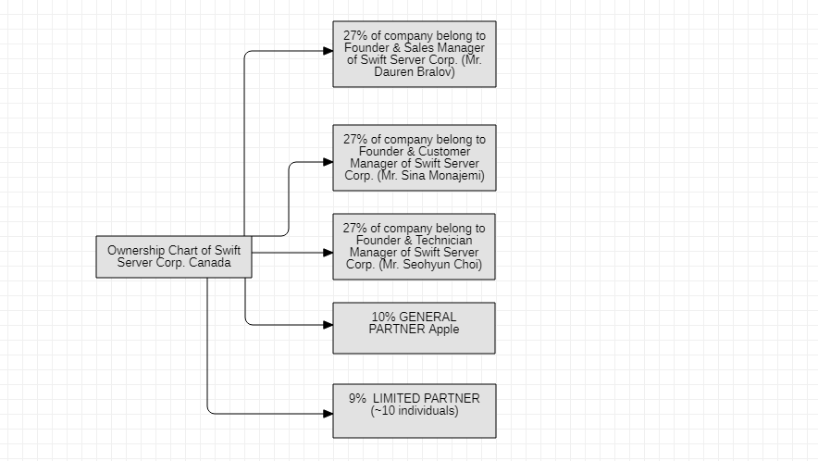
Ownership Chart

Slide 6


Products & Services
We developed a variety of Software Technologies meant to solve the problems most companies face these days.
We aim at Managing Accounting, Financial Operations, Optimizing Operations and Increasing Software Performance.

Slide 7

Prices
Free-Trial for the first month
Starting Price
CAD$ 29.99/month
CAD$ 24.99/month for Seneca graduates

Slide 8

Contact Us
Phone: +1-647-228-31-24
Email: malagratgea@gmail.com
Business Hours :
Monday - Friday 9:00 a.m. - 5:00 p.m.
Saturday 10:00 a.m. - 3:00 p.m.
Sunday CLOSED

Slide 9

If you have any questions about our company,
please contact us at the contact number mentioned above.

